Slide 1
Web mapping

Slide 2
contents
Introduction
Types of web maps
Examples
Map servers
Standard for web portrayal services

Slide 3
Introduction
“web mapping” refers at a minimum, to the following actions:
A client makes requests to one or more services registries(based on the OpenGIS Catalouge Services Specification) to discover URLs of Web Map Servers containing desired information.
Service registries return URLs and also information about methods by which the discovered information at each URL can be accessed.
The client locates one or more servers containing the desired information, and invokes them simultaneously.
As directed by the client, each Map Server accesses the information requested from it, and renders it suitable for displaying as one or more layers in map composed of many layers.
Map Servers provide the display-ready information to the Client(or Clients), which the display information from many sources in a single window.

Slide 4
Web maps: types
Static web map
Dynamically created web maps
Distributed web maps
Animated web maps
Real-time web maps
Personalized web maps
Interactive web maps
Analytic web maps
Collaborative web maps

Slide 5
Static web map
Are essentially the digital equivalents of paper maps.
User may be able to zoom in or out on the map, the content of the map is static.
Scale of the map cannot be changed.
Areas off the edges of the map cannot be viewed
Components of the map cannot be toggled on or off.
Is often a digital scan of paper map or an export from a GIS package.

Slide 6
Dynamically created web maps
Are generated on the fly when user loads the associated web page.
The of choice of whether to publish a static map or a dynamic map should depend on how frequently the map data change.
Consider the following three maps:
Population figures compiled by a census
Hometowns of students enrolled in a course
Locations of buses in a public transportation system
Scenario A calls for a static map, since the population data and the geographic subdivisions in which they were collected represent a snapshot in time. After the census is complete, the data should never change.
At the other end of the spectrum is scenario C. producing an accurate static map of the locations of buses is impossible since their positions are constantly changing. Obviously this scenario calls for the use of a dynamically generated map.
Scenario B represents a middle ground in which the data change every few months. It is not hard to imagine producing a new static map of the student hometowns for each new offering of the course without expending a whole lot of time or effort. However if a dynamically generated map application is constructed, a bit of up-front effort can eliminate the need to produce the same map manually again and again.

Slide 7
Distributed web maps
Is actually a sub-class of the dynamically created class.
The distinguishing feature of this category is that at least some of the data come from other servers.
This might involve the use of formal data sharing protocols such as the Open Geospatial Consortium’s Web Map Service(WMS), Web Feature Service(WFS) or Web Coverage Service(WCS) standards.
It could also involve the extraction from other websites of data that wasn’t expressly packaged for mapping purposes.

Slide 8
Animated web maps
Animated web maps are most often associated with the display of snapshots of the same map variable taken at different times.
Weather maps are also commonly animated to illustrate changing weather patterns.
Another use of map animation is for showing different map variables for the same place.
For example, one could animate a series of maps of any state depicting their population, income, education level, ethnicity, etc. Finally, animation can also be used to modify the user's view of the same map data through the use of zooming and panning; i.e., to create a "fly-through" of a place.

Slide 9
Real time web maps
In addition to fitting into the animated map category, weather maps are also perhaps the most commonly viewed type in the real-time map category.
The collection of data required for a real time map is usually automated through the use of sensors, such as those installed along urban road networks to detect vehicular traffic.
Other examples in this category include locational maps of the various entities that we outfit the GPS transceivers such as vehicles, wildlife.

Slide 10
Personalized web maps
Sites that allowed the user to have some input into the look of the map.
Such input could include its color scheme, classification method, title, legend, scale bar or any other map element that one might have control over when constructing a map in a GIS package.

Slide 11
Interactive web maps
Includes the ability to change the map’s extent through zooming and panning. Other forms of interactivity include the ability to:
Toggle map layers on or off
Obtain detailed information about map features
Browse to web sites associated with map features
Produce a personalized map,
And explore data patterns and relationships using visualization tools that are dynamically linked to the map.

Slide 12
Analytic web maps
Applications that enabled the public to perform analyses that had previously only been available to GIS professionals.
The most common analytic function performed by web map applications is route finding.
Overlay analysis, which is an integral part of any GIS package, is another function that is often found in web maps in this category.

Slide 13
Collaborative web maps
Openstreet Map: Crowd Sourcing

Slide 14
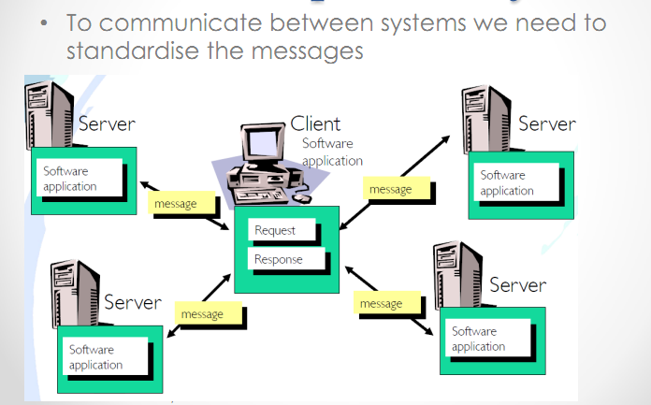
Interoperability

Slide 15
Interoperability
“the capability to communicate, execute programs, or transfer data among various functional units in a manner that requires the user to have little or no knowledge of the unique characteristics of those units.”
-ISO 1993

Slide 16
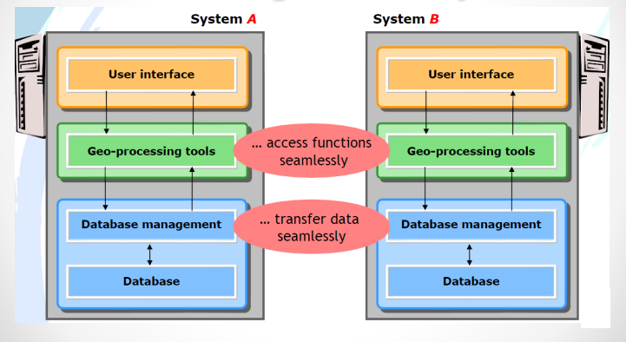
Interoperability

Slide 17
How to achieve interoperability?
Make data seamlessly transferable & accessible.
Encode data in a standardized, platform & application independent manner
XML
Access distributed functionality seamlessly
Specify and set up an infrastructure of interoperable(software) services, which encapsulate functionality and make it accessible via well specified interfaces
Web services

Slide 18
Open Geospatial Consortium(OGC)
Focus on interoperability of software at the interface level to promote plug and play components for geographic information interchange
Non profit, international consortium
220+ industry, government, NGO and university members

Slide 19
Open Geospatial Consortium(OGC)
OGC provides services with a standardized interface:
Web Map Service(WMS): displays an image(gif, jpeg, png) of vector or raster data
Web Feature Service(WFS): provides access to vector data(output in Geography Markup Language(GML))
Web Coverage Service(WCS): provides access to metadata of geodata and services.
Web Processing Service(WPS): provides access to remote GIS operations(for example Buffer, distance calculation, coordinate transformation) responses are standard-based messages.

Slide 20
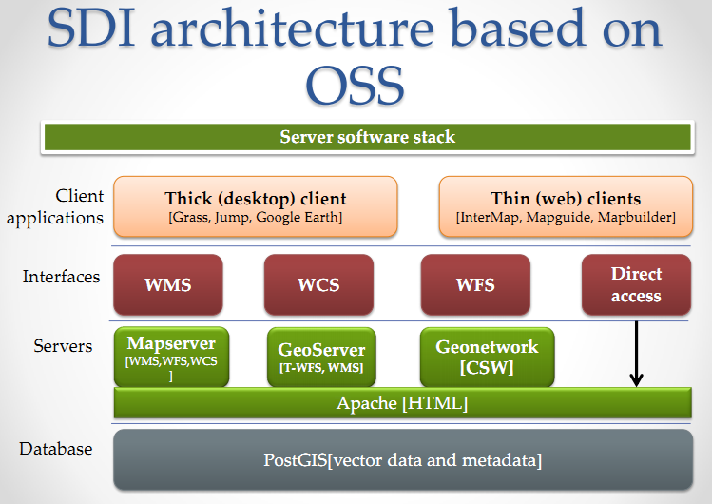

Slide 21
Map Servers
A map server can do three things. It can:
Produce a map(as a picture, as a series of graphical elements, or as a packaged set of geographic data),
Answer basic queries about the content of the map, and
Tell other programs what maps it can produce and which of those can be queried further.

Slide 22
Available mapserver softwares
ArcGIS server
“mapserver” developed by university of Minnesota
Geoserver
World wind WMS server

Slide 23
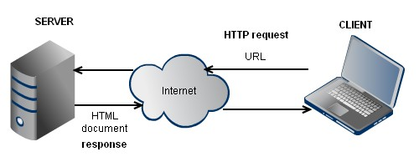
Client server technology for web mapping

Slide 24
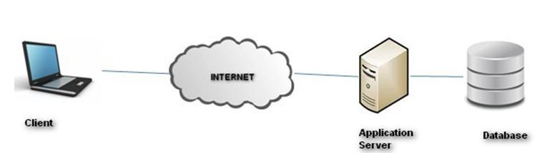
Client server technology for web mapping

Slide 25
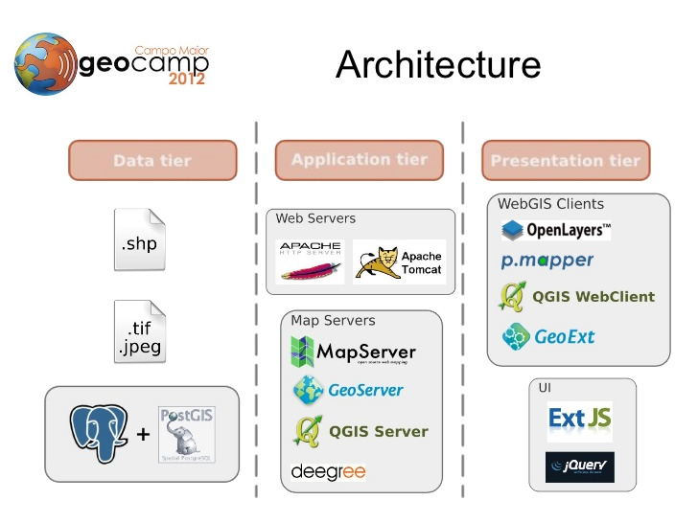
Client server technology for web mapping

